Slide 1
ACROPOLIS INSTITUTE OF TECHNOLOGY AND RESEARCH
DEPARTMENT OF
INFORMATION TECHNOLOGY
MAJOR PROJECT PRESENTATION
Smart Reminder System
Class- IT-2
Submitted By :- Project Coordinator:-
Sagar Gupta Mr. Praveen Bhanodia
Sahaj Sugandhi
Soumya Joshi Project Guide :-
Mr. Ajay Khatri

Slide 2
Content
Abstract
Introduction
Problem Statement
Project Objectives
Survey of Existing System
Solution Proposed
E-R Diagrams
Expected Outcomes
Scope
Limitations
Conclusion

Slide 3
ABSTRACT
In this project, we have tried to design an application which gives alert about the reminder when he enters into the geographical region specified in the reminder.
Since people are most likely to use mobile phones when on-the-go and away from home or office, apps that leverage location-based services can add real value to the user and thus provide a good return-on-investment for the mobile device.

Slide 4
INTRODUCTION
The importance and usefulness of location-sensing has already been well recognized and accepted, with the popularity of GPS based navigation systems. Not surprisingly, most of the today's smart-phones have location sensing capabilities built in.
This report presents a reminder system that allows users to create location reminders and be alerted when they enter or exit the vicinity of a given location. It provides a highly useful set of integrated location based services.

Slide 5
Problem Statement
Most of the reminder applications available today in mobile phones are time and date based. In which the user has to save the time and date of when he wants to be reminded about in the reminder. If the reminder is ON, the device continuously tries to match the device time and date with the saved time and date, and the user will be alerted if it is a match.
But in many cases the user will not be aware about the time and date, but he will be aware about the place where he wants the reminder.
Hence we tried to design a location based reminder system.

Slide 6
Project Objective
To design a mobile application that provides personal location-based services such as –
Reminders:- To make notes and list to get reminded about events
Location:- To set reminder based on locations
Bookmarking:- To bookmark the reminders
Send Reminder:- To set reminder for others and send them.
Search nearby:- To get notified for nearby location and places according to requirements.

Slide 7
Survey of Existing System
S.No | Existing System | Features | Disadvantages | Limitations
1. | Google Keep | We can create checklists User can keep lists organized Integrated with Google | Keep lacks rich text format in notes. Google Keep lacks categorization | Unmanageable for long list of notes Doesn’t support location based notes
2. | Any.do | User can create to-do lists Provide location based reminder Customization of lists | Paid application Not a reliable application | Can’t interpret natural language Complicated for normal user

Slide 8
Solution Proposed
Our project, SMART REMINDER SYSTEM, provides a highly useful set of integrated location based services such as:
1. A reminder system that allows users to create location reminders and be alerted when they enter or exit the vicinity of a given location.
2. Adding notes and Lists for the reminder, there will be no need of carrying papers and pen.
3. It will also feature simple time based reminder system.
4. Smart Reminder for Elderly People, the family members can inform there elders for reminders of medicines and other works.

Slide 9
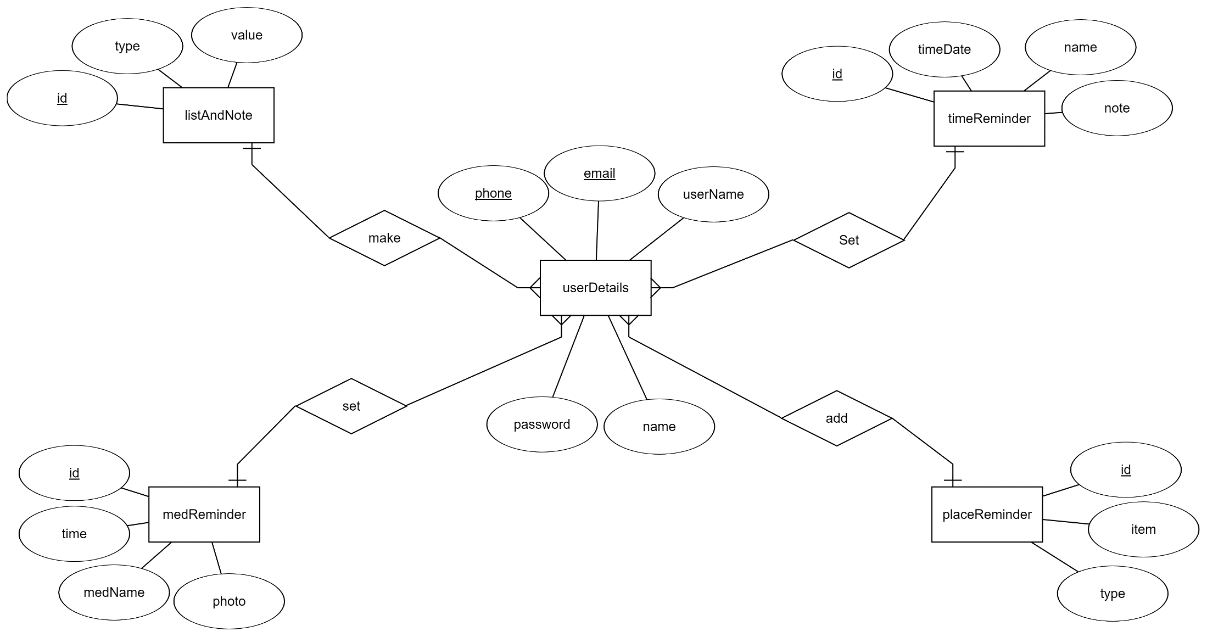
Entity-Relationship Diagram

Slide 10
EXPECTED OUTCOMES
Our application, SMART REMINDER SYSTEM, will provide a location based reminder system which will alert about the reminder when the person enters into the geographical region specified in the reminder.
Since it is a medicine reminder also, it will help a user to track that the elderly people at the home took the medicines or not.
In a nutshell, we are going to develop an application, which will track users location and remind them at a certain place according to their settings.

Slide 11
SCOPE
Here we can explore some of these exciting possibilities and discuss our future plans for adding new features that build upon and compliment the current functionality.
Social networking features can help leverage the location based services, adding a whole new dimension of possibilities. For example, sharing of bookmarked locations between facebook friends would make it easy for people to exchange addresses of popular restaurants, tourist attractions etc.

Slide 12
LIMITATIONS
At this stage the application can not add retail shops for the products, it will remind only for the stores which are present in the Google Maps.
Users can not keep record of old reminders.

Slide 13
CONCLUSION
In a nutshell, we are going to develop an application, which will track users location and remind them at a certain place according to there settings, this application will also provide the simple reminder services like time based reminder and helps in keeping notes and list in the application. Also it will help a user to track that the elderly people at the home took the medicines or not, and remind for the same to the responsible person so that, the responsible person can take the necessary actions.

Slide 14
THANK YOU !!

